Slide 1
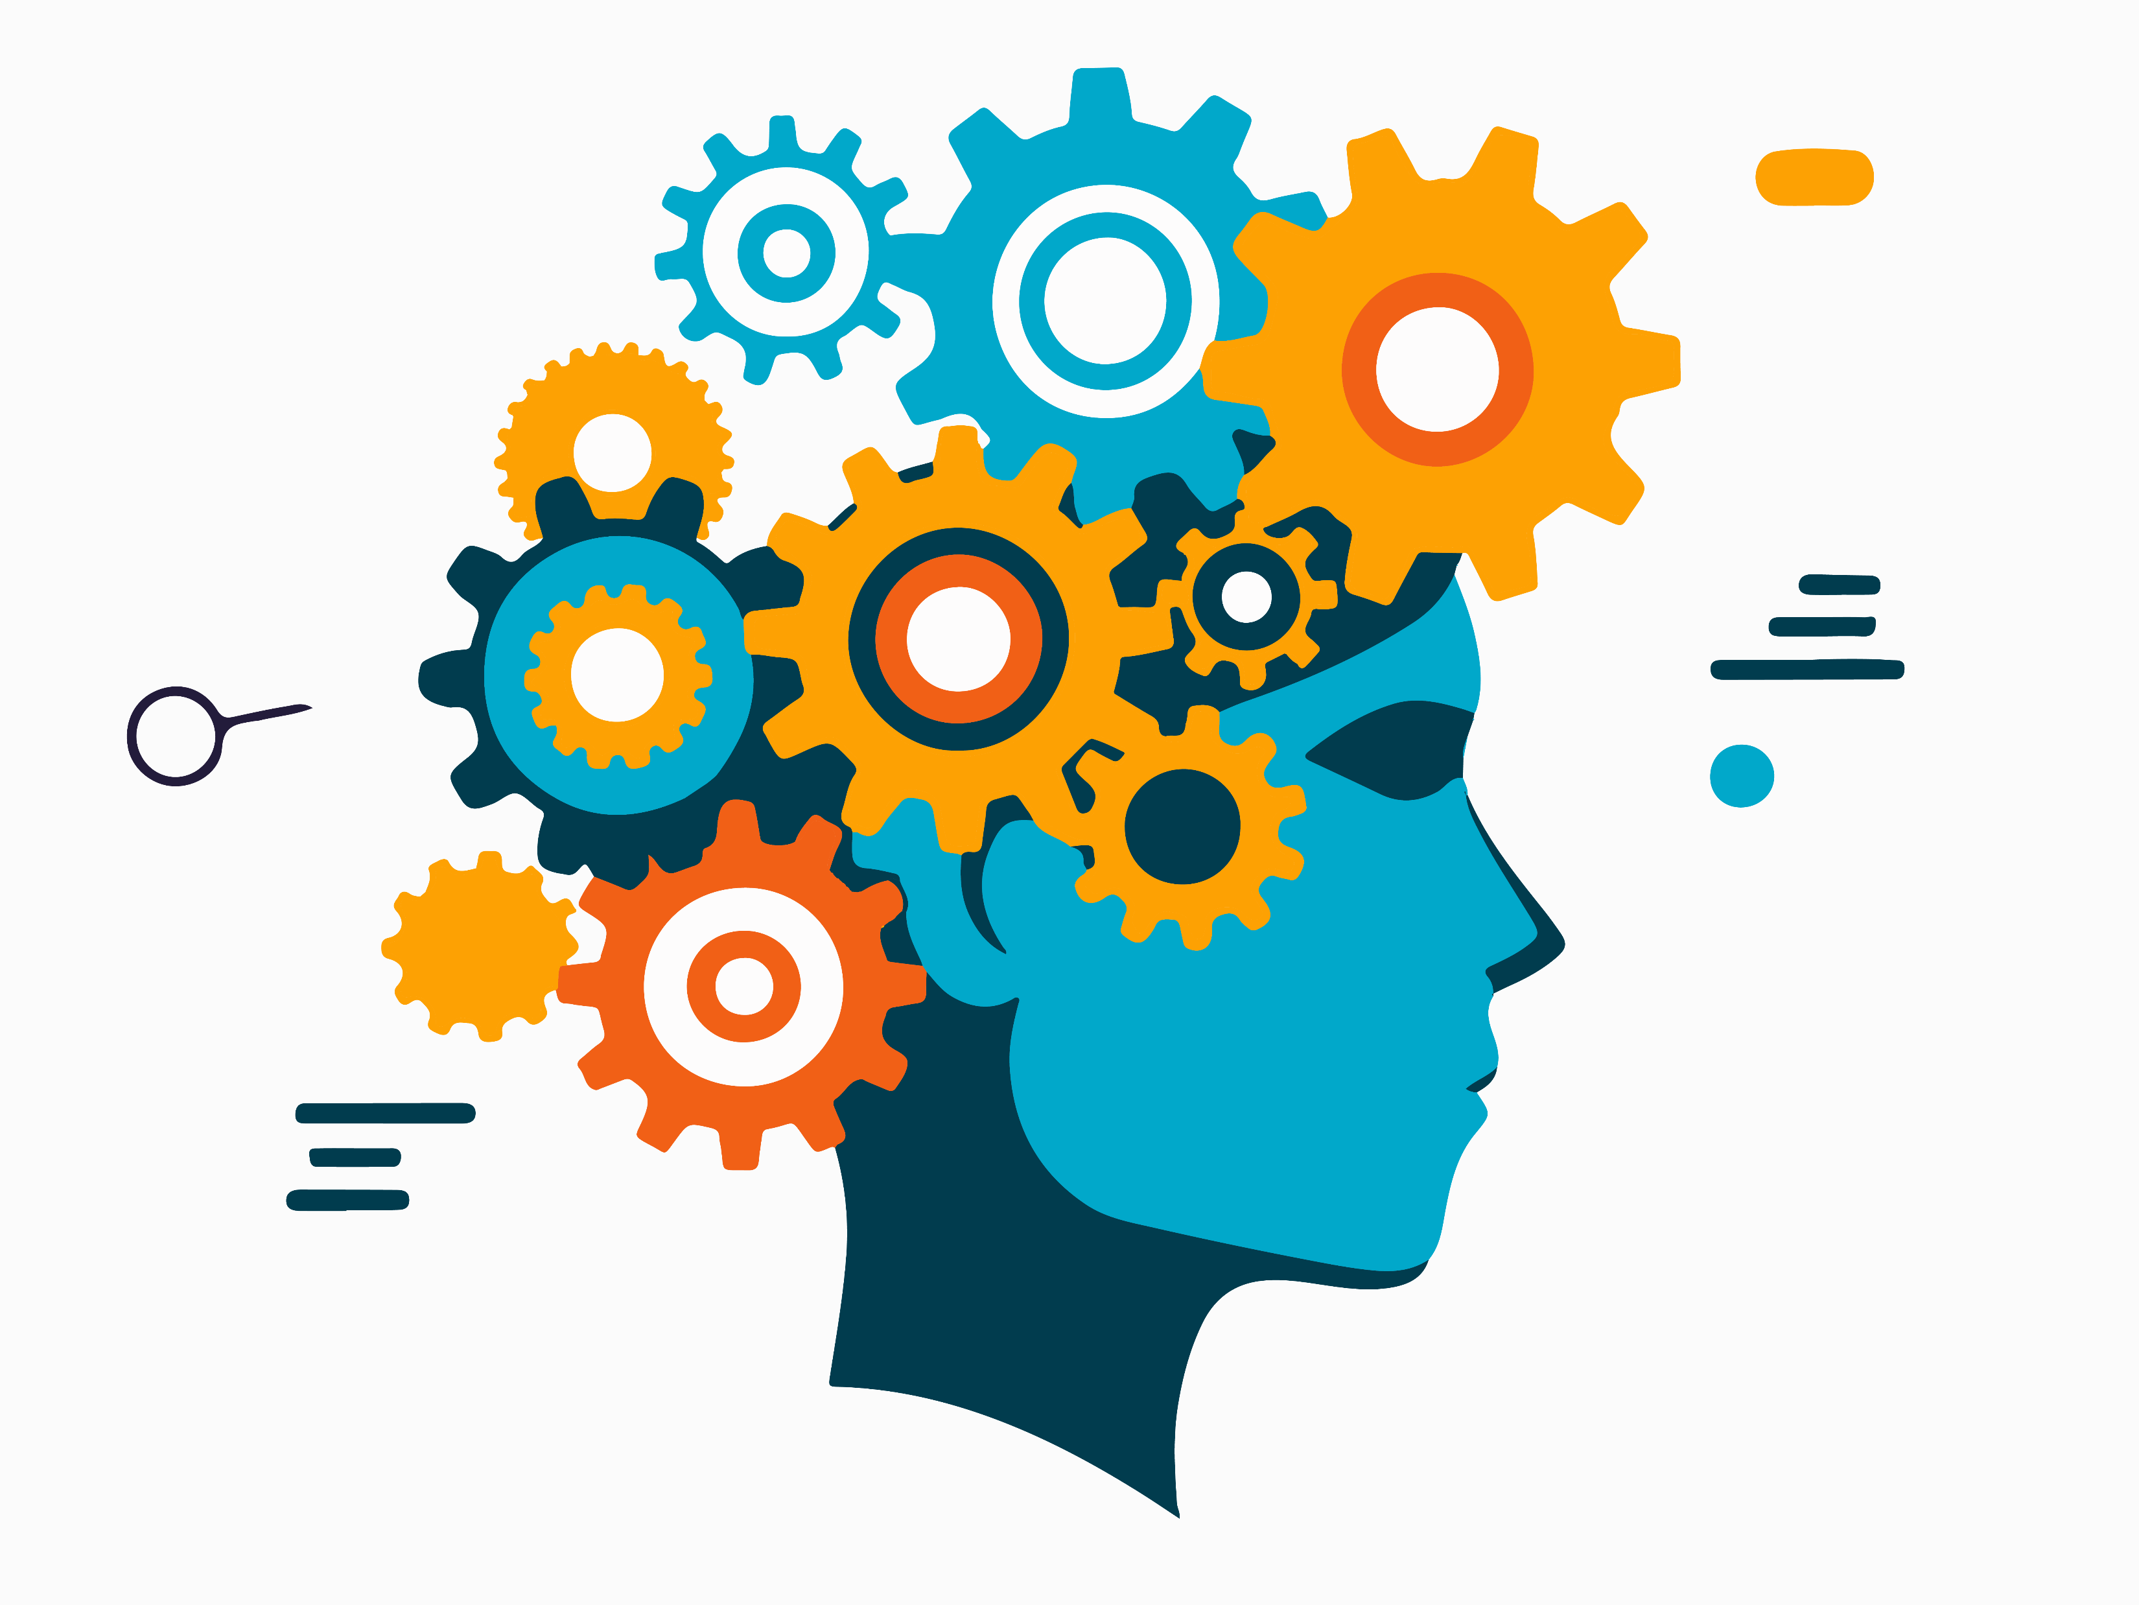
Word2Vec & Word Embeddings
Week 5
CSY3055 – Natural Language Processing
Dr Oluseyi Oyedeji

Slide 2


How can a computer tell that ‘doctor’ and ‘nurse’ are related, or that ‘king – man + woman = queen’? Do machines actually understand meaning?
Today we’ll see how they do it, through word embeddings, where words become numbers that carry meaning.

Slide 3
Learning Goals for Week 5
By the end of week five, you should be able to:
Explain distributional semantics [ “a word is known by the company it keeps.” ]
Describe how Word2Vec learns vector representations (CBOW & Skip-gram).
Understand the mathematics behind Word2Vec’s learning process.
Compare Word2Vec and GloVe embeddings. Gensim
Train and test a small Word2Vec model using.
Evaluate word similarities and analogy tasks.
Reflect on bias in embeddings and how to detect it.

Slide 4
Relevance
Word embeddings form the foundation of modern NLP as they transform text into numerical vectors that capture meaning.
Every transformer model (BERT, GPT, etc.) begins with this same idea.
Understanding embeddings bridges your knowledge from classical NLP (TF-IDF) to deep learning.

Slide 5
Today’s Session
Introduction
Distributional Semantics
Word2Vec
GloVe
Ethical reflection on bias

Slide 6
Introduction

Slide 7
From Words to Numbers
Computers understand only numbers.
Earlier methods (Bag-of-Words, TF-IDF) counted occurrences but ignored meaning:
These are frequency counts, not relationships.
“cat” | “dog” | “car”
3 | 2 | 0

Slide 8
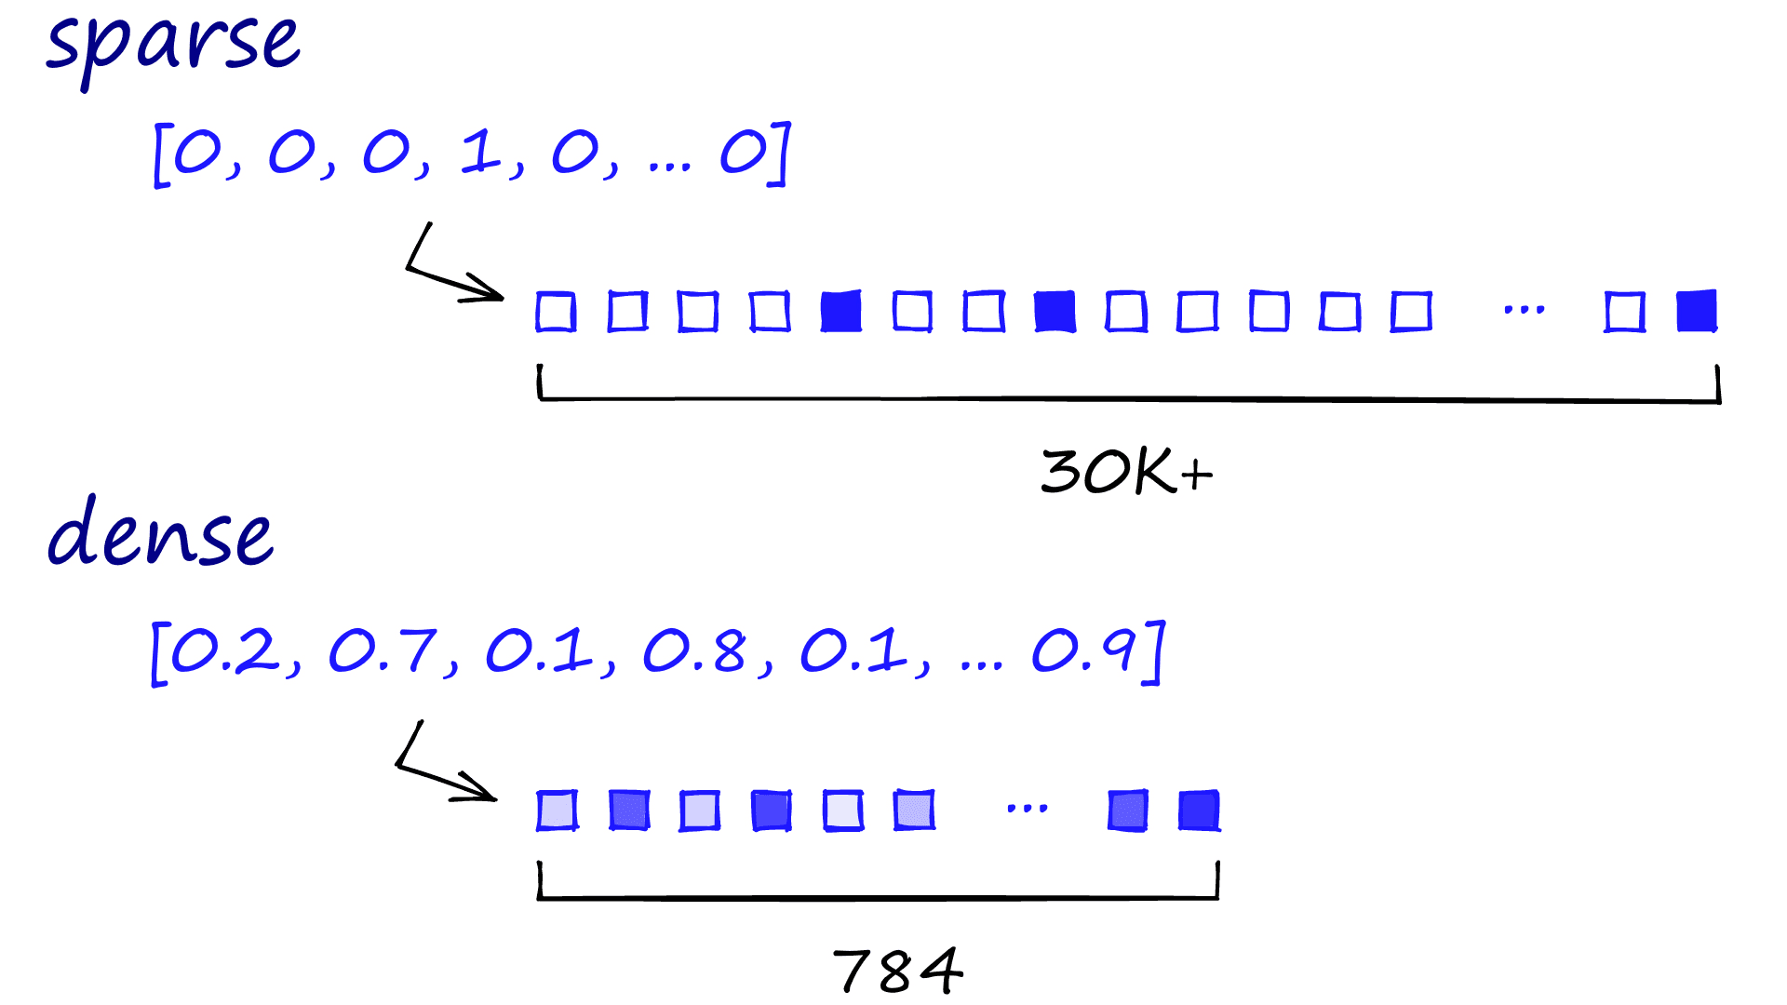
From Words to Numbers contd.
Word2Vec instead learns how words occur together, producing dense vectors such as
cat = [0.23, –0.14, 0.88, …] - this encode semantic similarity.

Slide 9
Distributional Semantics
“You shall know a word by the company it keeps.” – J.R. Firth (1957)
Words appearing in similar contexts tend to mean similar things.
“dog” and “cat” share contexts like pet, food, cute;
“car” and “bus” share road, driver, wheel.
Word2Vec converts these contextual co-occurrences into positions in a semantic space.

Slide 10
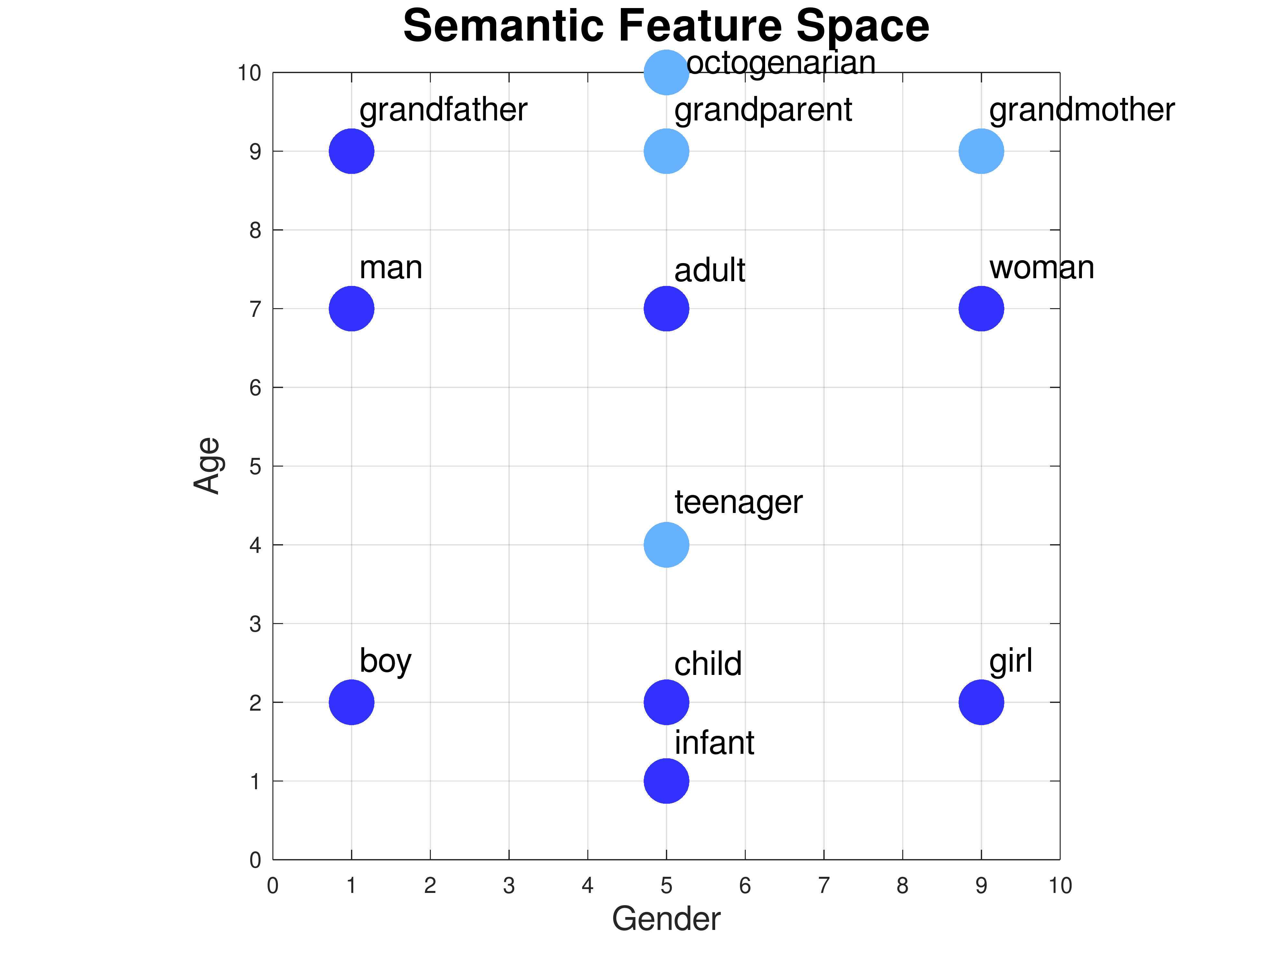
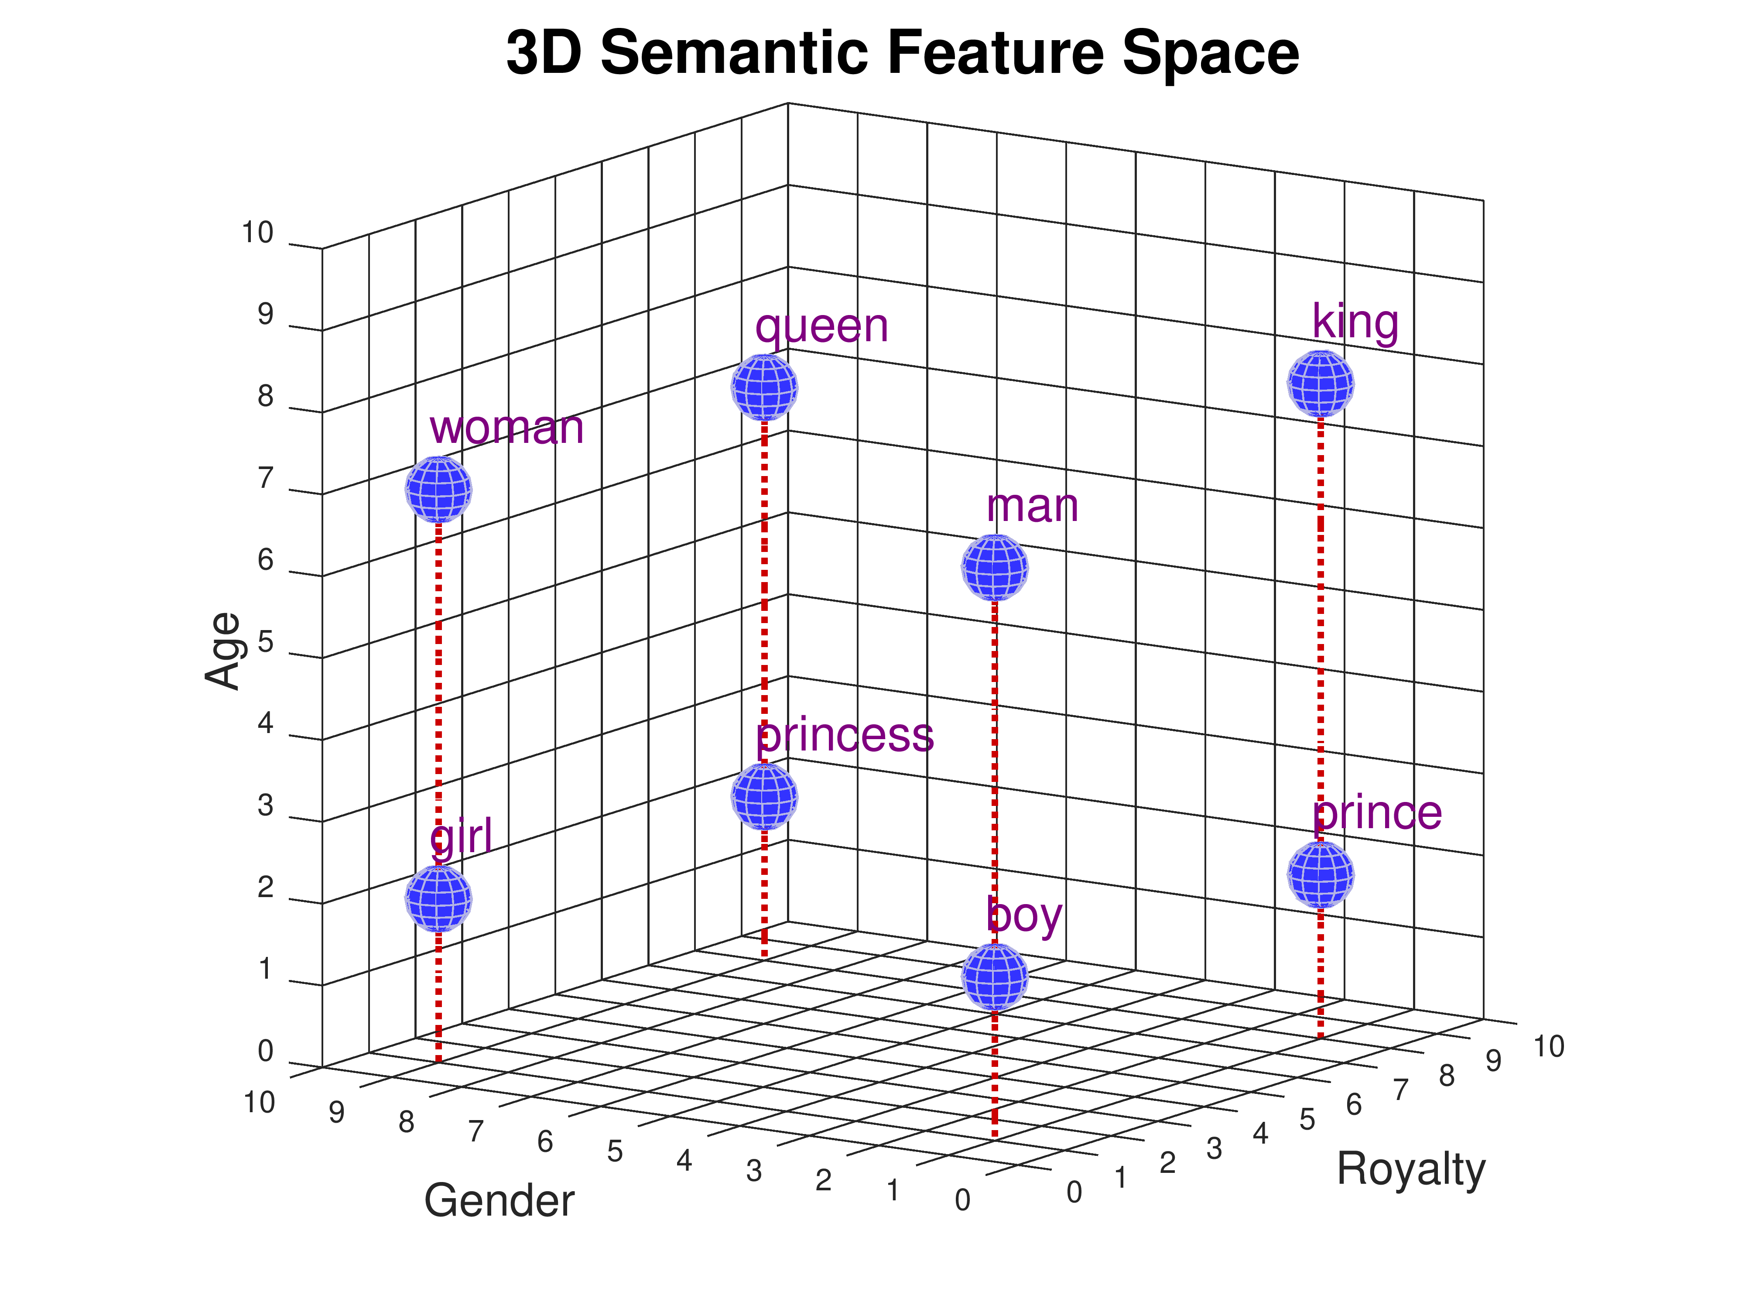
Distributional Semantics contd.
Conceptual Semantic Space

Slide 11
Word2Vec

Slide 12
What is Word2Vec?
Word2vec is a technique in natural language for obtaining vector representations of words.
These vectors capture information about the meaning of the word based on the surrounding words.

Slide 13
Word2Vec Architectures
Continuous Bag of Words (CBOW)
Predicts the target word based on the context words around it.
Skip-Gram
Predicts the context words based on the target word.
Model | Predicts | Description | When to use
CBOW | Target from context | Predict missing word from its neighbours | Faster; good for large data
Skip-gram | Context from target | Predict nearby words from the centre | Better for small or sparse data

Slide 14
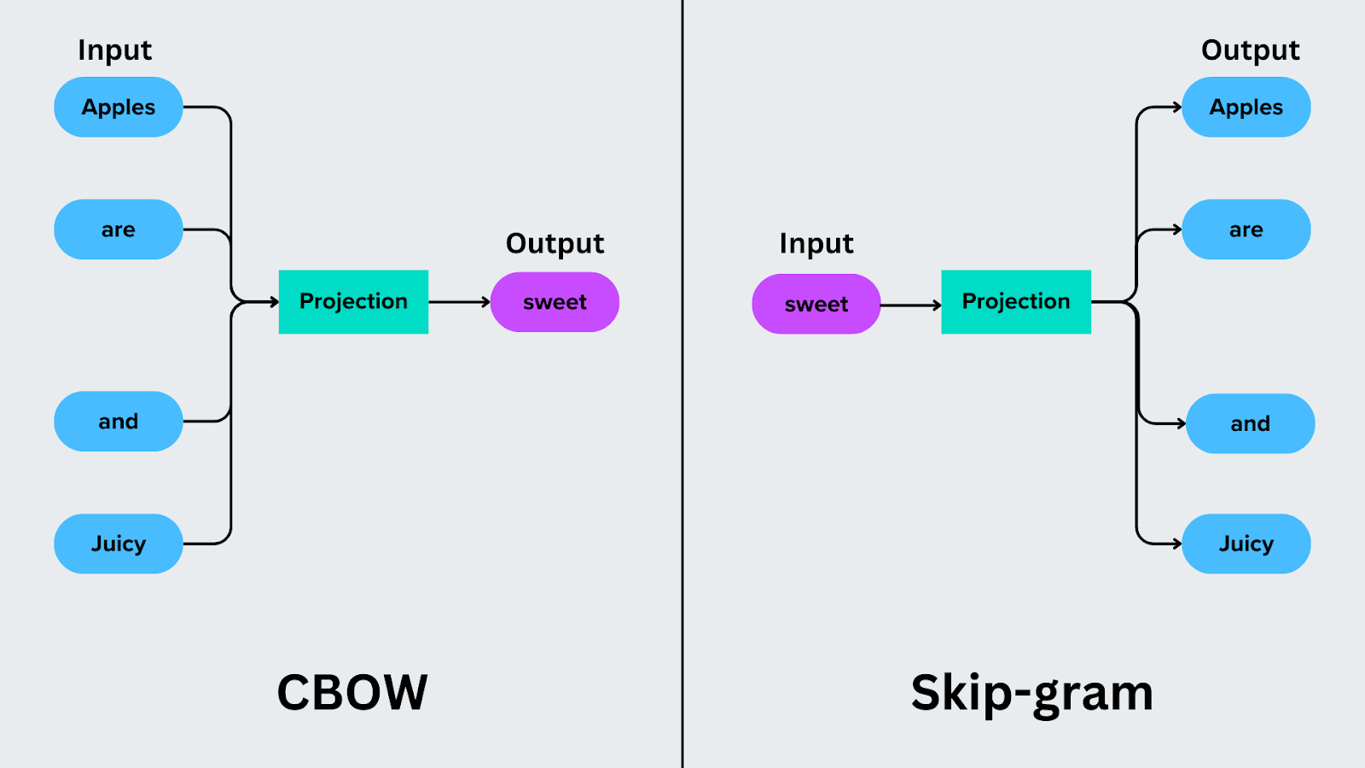
Word2Vec Architectures contd.

Slide 15
Inside the Word2Vec Neural Network (Skip-Gram)
Word2Vec is a shallow neural network with three layers:
Layer | Description | Example (Skip-gram)
Input layer | Takes one word (as a one-hot vector). | e.g. cat = [0,0,1,0,0,…]
Hidden (embedding) layer | A linear layer that converts the one-hot input into a dense vector. | Multiplies input by a weight matrix → produces the word embedding.
Output layer | Predicts which context words appear nearby. | Gives a probability distribution over all words (softmax).

Slide 16
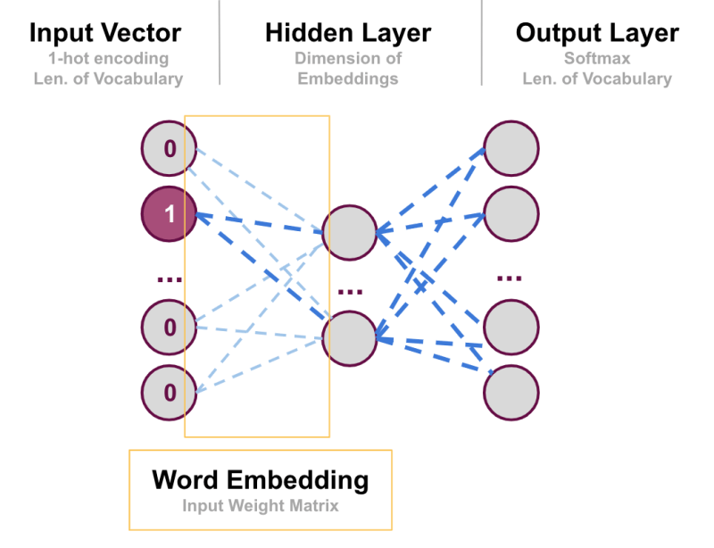
Inside the Word2Vec Neural Network

Slide 17
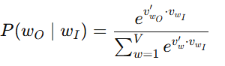
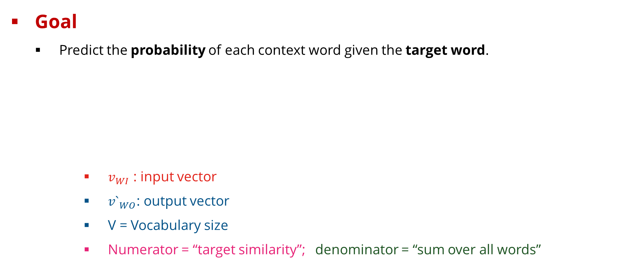
Foundation and Formula
Goal
Predict the probability of each context word given the target word.
$v_{WI}$ : input vector
${v`}_{WO}$: output vector
V = Vocabulary size
Numerator = “target similarity”; denominator = “sum over all words”

Slide 18
Predicting Nearby Words (Skip-gram)
Word2Vec learns to predict context words given a target word.
Example: “The cat sat on the mat.”
Target = cat
Context(Window = 2) = {the, sat, on}
Training pairs
(cat → the)
(cat → sat)
(cat → on)

Slide 19
Predicting Nearby Words (Skip-gram)
The model should assign higher probability to real contexts and lower to random ones
The cat sat on the mat
Across many sentences:
(cat → mat)
Across many sentences, “cat” and “mat” often co-occur, so the model still learns them as semantically related.

Slide 20
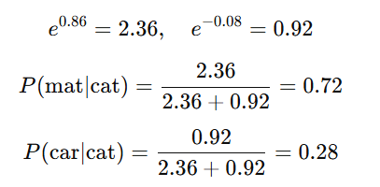
Worked Example [Conceptual]
Compute Similarity (dot product)
Apply Softmax (convert to probabilities)
“mat” is 72 % likely near “cat”; “car” is 28 %.
That’s meaning emerging from numbers.
Pair | Dot Product
cat·mat | 0.86
cat·car | -0.08

Slide 21
From Training to Embeddings
The output layer is discarded; we only keep the hidden layer weights.
Each word now has its own embedding vector.
Words that appear in similar contexts have similar embeddings.
Word | Embedding (simplified)
cat | [0.35, 0.77, 0.12, …]
dog | [0.33, 0.79, 0.14, …]
car | [0.10, –0.55, 0.82, …]

Slide 22
How Word2Vec Learns from Data
Word2Vec improves by comparing real word pairs vs random ones and adjusting its internal weights to get better at prediction.
The model starts with random numbers for every word.
Each time it predicts correctly (e.g., cat → mat), it slightly strengthens that connection.
Each time it predicts wrongly (e.g., cat → car), it weakens that connection.
Thousands of small adjustments make the model better at spotting meaningful relationships.

Slide 23
How Word2Vec Learns from Data contd.
dog
mat
sat
“cat”
car
banana

Slide 24
Training Faster with Negative Sampling
Predicting across 100,000 words is too slow.
Instead, we train with
1 true context word
a few random “noise” words (negatives)
The model learns to tell true from fake.
Target Word | Real Context | Fake Contexts
cat | mat 🟢 | car 🔴, sky 🔴, banana 🔴

Slide 25
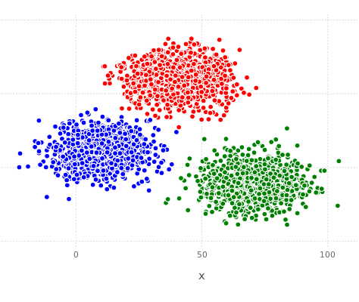
The Word Embedding Space
Each word → one dense vector.
Similar meanings → closer points.
Examples:
cat, dog, rabbit → cluster together
car, bus, train → another cluster
apple, orange, banana → another

Slide 26
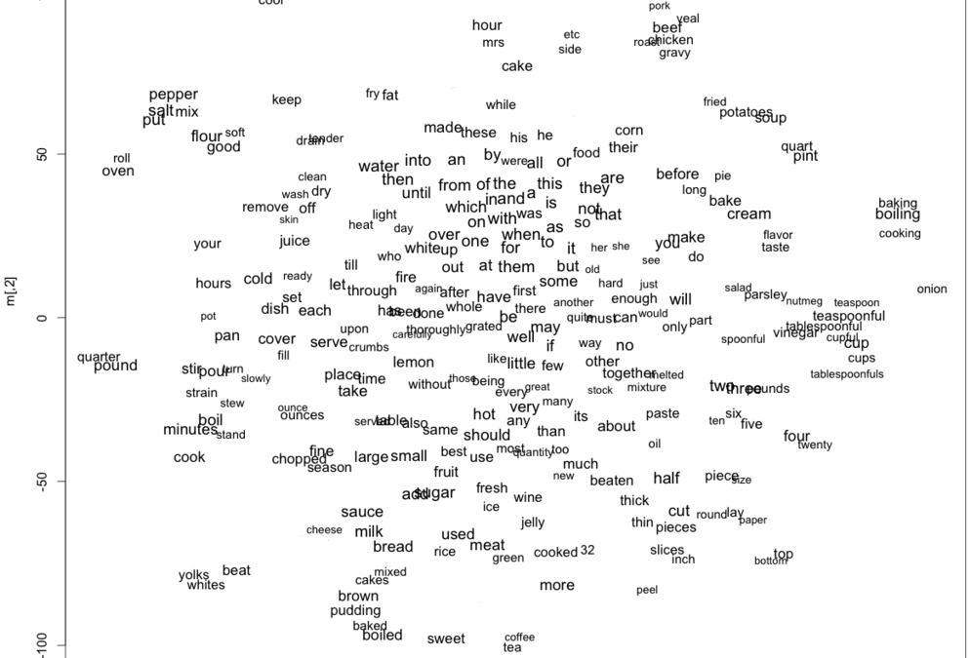
The Word Embedding Space contd.

Slide 27
How We Measure Word Similarity
Cosine similarity looks at direction, not length.
Two words pointing the same way = similar meaning.
Example:
cat–dog: very similar
cat–car: not similar
car–bus: similar
bus
cat
dog
dog

Slide 28
Bias in Embeddings
Because models learn from human text, they absorb human stereotypes.
Example analogy:
man : computer programmer :: woman : homemaker
Bias can influence translation, hiring systems, and chatbots.
Mitigation
balanced corpora, bias detection tests, documentation, or debiasing algorithms.

Slide 29
Summary - Word2Vec
Step | Description
1 | Text → one-hot vectors
2 | Model predicts nearby words
3 | Adjusts weights , pulls similar, pushes different
4 | Keep hidden layer as word embeddings
5 | Measure meaning with cosine similarity

Slide 30
Glove

Slide 31
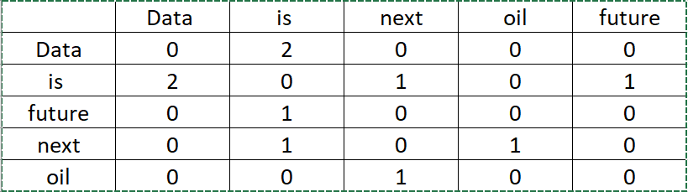
What is GloVe?
Glove means Global Vectors for Word Representation
GloVe learns word meanings by studying global co-occurrence patterns across the entire text, not just nearby words like Word2Vec.

Slide 32
What is GloVe?
Developed by researchers at Stanford.
Uses statistics of word co-occurrence, how often words appear together in the whole corpus.
Learns embeddings so that the ratios of co-occurrence probabilities capture meaning.

Slide 33
GloVe vs Word2Vec
Feature | Word2Vec | GloVe
Approach | Predicts context words using a neural net | Learns from co-occurrence matrix (count-based)
Focus | Local context (sliding window) | Global statistics (entire corpus)
Learning Objective | Predict probabilities | Factorize co-occurrence ratios
Strengths | Efficient, good for streaming data | Captures long-range meaning better
Output | Dense word vectors | Dense word vectors

Slide 34
Reference
Mikolov, T., Chen, K., Corrado, G., & Dean, J. (2013). Efficient estimation of word representations in vector space. arXiv preprint arXiv:1301.3781.
Mikolov, T., Sutskever, I., Chen, K., Corrado, G. S., & Dean, J. (2013). Distributed representations of words and phrases and their compositionality. Advances in Neural Information Processing Systems 26, 3111–3119.
Pennington, J., Socher, R., & Manning, C. D. (2014). GloVe: Global vectors for word representation. Proceedings of EMNLP 2014, 1532–1543.

Slide 35
Practical & Wrap-Up

Slide 36
Thank you

